Slide 1
Linear Discriminant
Analysis (LDA)
Aksadur Rahman
aksadur@yahoo.com

Slide 2
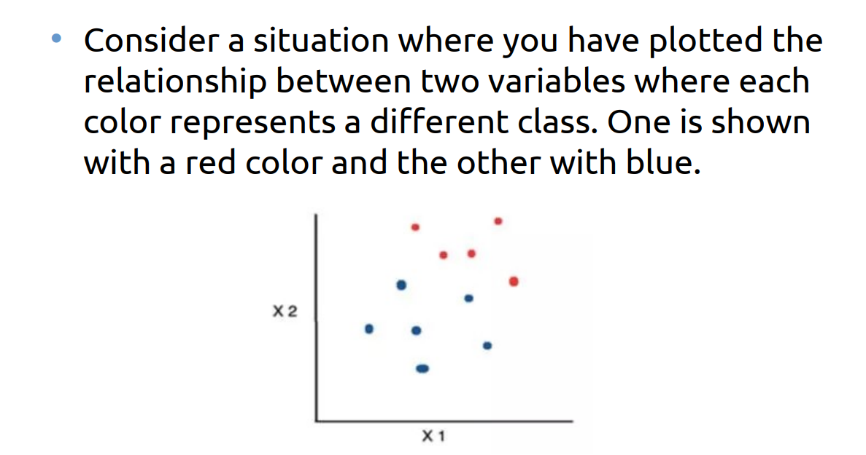

Slide 3
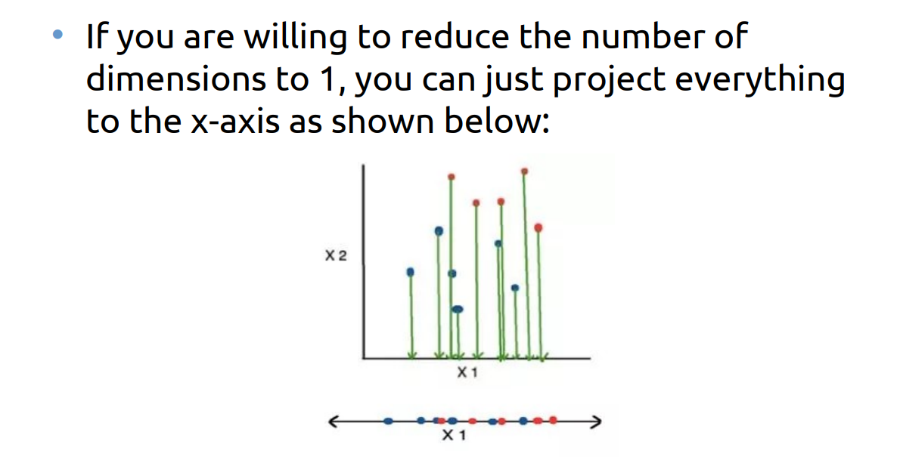

Slide 4
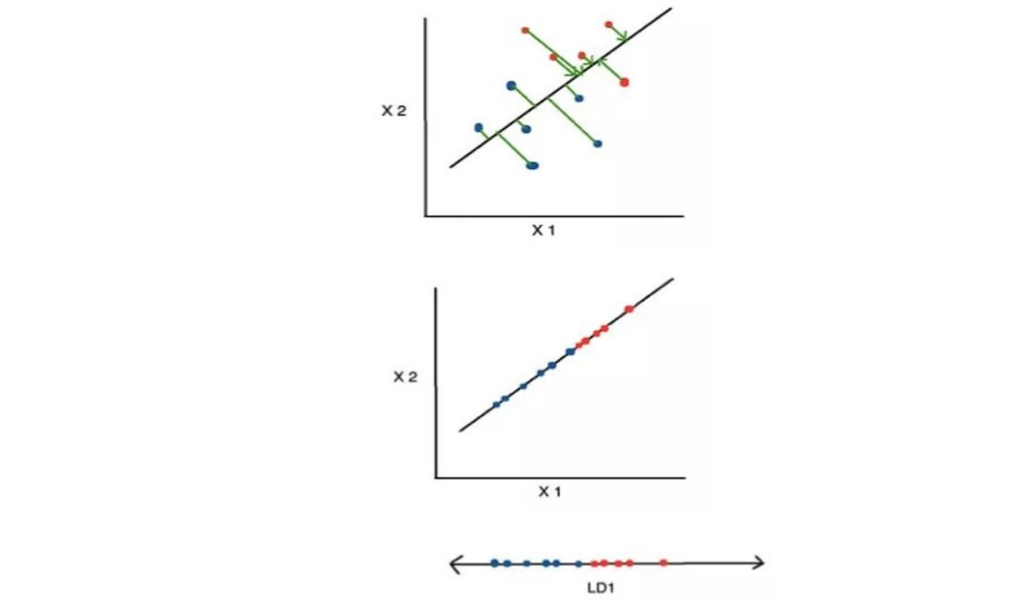

Slide 5
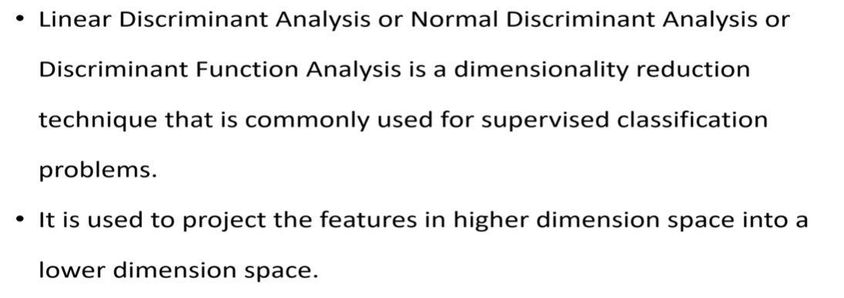

Slide 6
How do PCA and LDA differ?
PCA | LDA
PCA is an unsupervised technique | While LDA is a supervised technique.
This means that PCA does not use any class labels or target variables to perform the dimensionality reduction | While LDA does.
PCA only considers the variation or structure of the data | While LDA considers both the variation and the class information of the data.

